Slide 1
Obstacle Avoiding Robot
Fabliha Noshin Sithi Kazi Fatema
Roll: 1974 Roll: 1975
MD Nuruzzaman Sojib Nusaiba Kalam
Roll:2000 Roll: 1984

Slide 2
Title and Content Layout with List
Chassis OR any toy car.
Arduino UNO/Mega.
Ultrasonic sensor HC SR-04.
4 DC motors.
9V/12V 1A battery.
Motor driver module L298.
Jumpers.
Single stranded wires.

Slide 3
Connections
Connections of L298N
Connections of Ultrasonic sensor
VCC – VCC terminal of Arduino.
GND – GND terminal of Arduino.
Trigpin – digital pin 3 on Arduino.
Echo pin – digital pin 4 on Arduino.
+12V – Positive terminal of the battery.
GND – Negative terminal of battery.
ENA – Pin 10
ENB – Pin 9
Input terminal 1 – Pin 5
Input terminal 2 – Pin 6
Input terminal 3 – Pin 7
Input terminal 4 – Pin 8
Output terminal 1 – Negative of first and second motor.
Output terminal 2 – Positive of first and second motor.
Output terminal 3 – Negative of third and fourth motor.
Output terminal 4 – Positive of third and fourth motor.

Slide 4
Procedure
Connections of Ultrasonic sensor
Connections of L298N
Code
Testing
Circuit Diagram

Slide 5
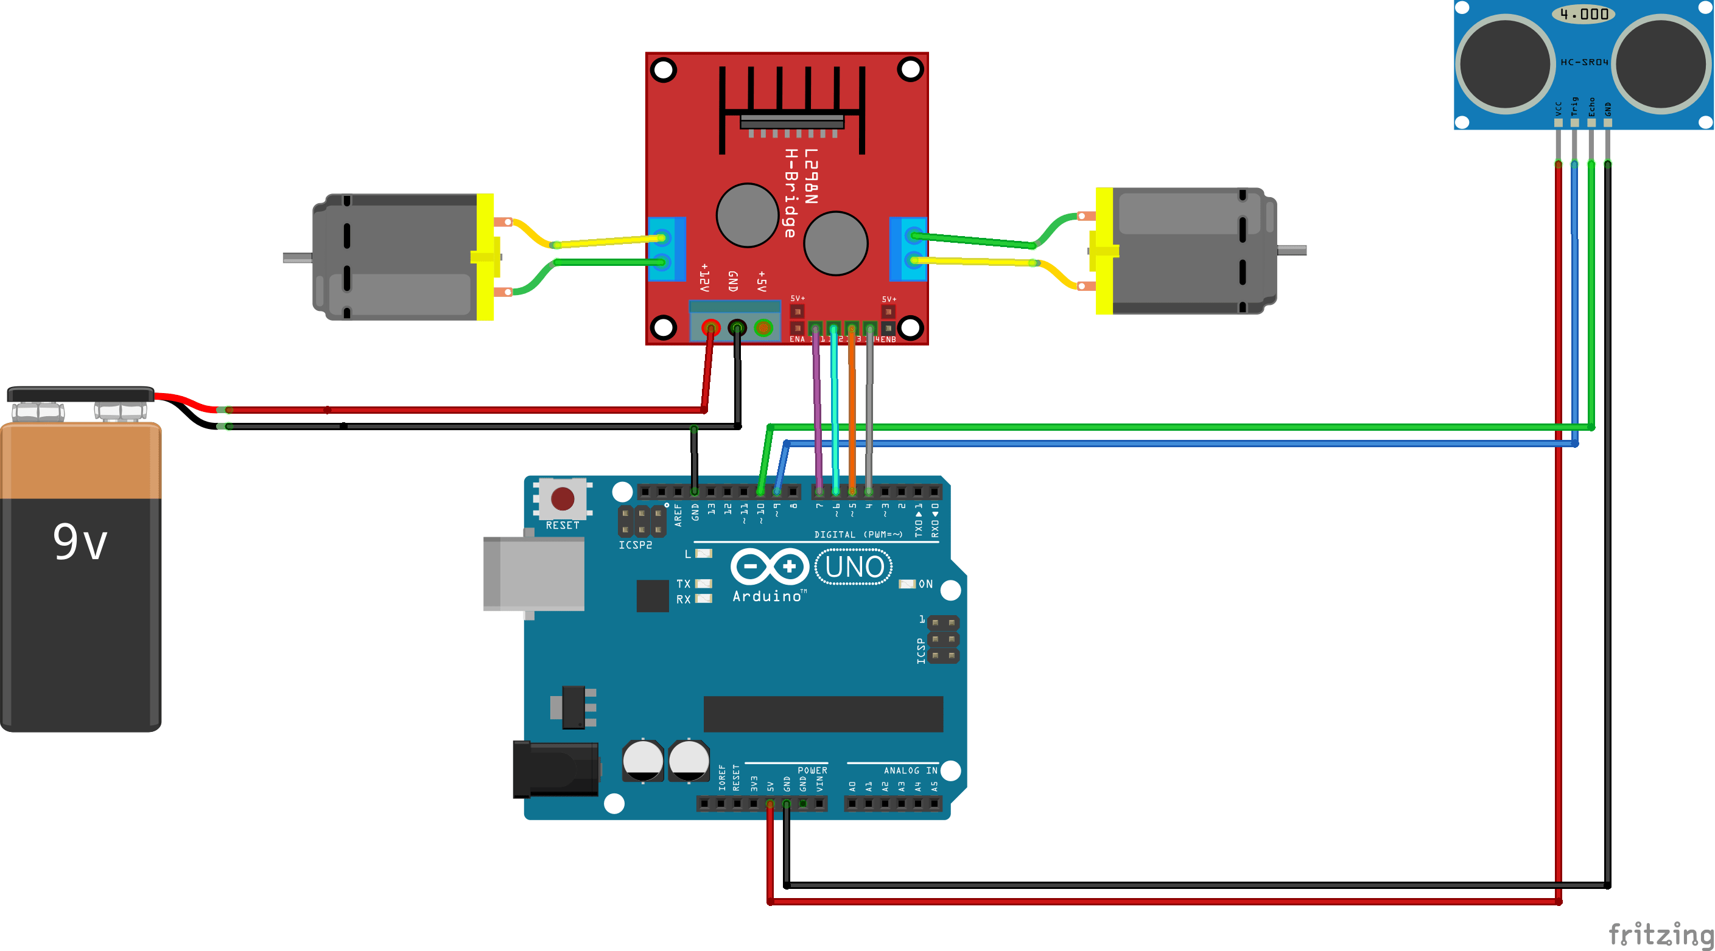
Circuit Diagram

Slide 6
Connections of Ultrasonic sensor
Arduino is the main processing unit of the robot. Out of the 14 available digital I/O pins, 7 pins are used in this project design.
The ultrasonic sensor has 4 pins: Vcc, Trig, Echo and Gnd. Vcc and Gnd are connected to the +5v and GND pins of the Arduino. Trig (Trigger) is connected to the 3rd pin and Echo is connected to 4th pin of the Arduino UNO respectively.

Slide 7
Connections of L298N
The L298N is a dual H-Bridge motor driver which allows speed and direction control of two DC motors at the same time. The module can drive DC motors that have voltages between 5 and 35V, with a peak current up to 2A.
+12 V and GND of the L298N is connected to the positive and negative terminal of the battery respectively.
ENA terminal of the L298N is connected to Arduino Pin 10. ENB terminal is connected to Arduino Pin 9.

Slide 8
Connections of L298N
Input Terminal 1, Input Terminal 2, Input Terminal 3 and Input Terminal 4 of the L298N are respectively connected to Arduino Pin 5,Pin 6,Pin 7,Pin 8.
Output Terminal 1 and Output Terminal 2 is respectively connected to the negative and positive terminals of the first and second DC motor. On the other hand, Output Terminal 3 and Output Terminal 4 is respectively connected to the negative and positive terminals of the third and fourth DC motor.

Slide 9
Working Procedure
Before going to working of the project, it is important to understand how the ultrasonic sensor works. The basic principle behind the working of ultrasonic sensor is as follows:
Using an external trigger signal, the Trig pin on ultrasonic sensor is made logic high for at least 10µs. A sonic burst from the transmitter module is sent. This consists of 8 pulses of 40 KHz.
The signals return back after hitting a surface and the receiver detects this signal. The Echo pin is high from the time of sending the signal and receiving it. This time can be converted to distance using appropriate calculations.
The aim of this project is to implement an obstacle avoiding robot using ultrasonic sensor and Arduino. All the connections are made as per the circuit diagram. The working of the project is explained below.

Slide 10
Working Procedure
When the robot is powered on, both the motors of the robot will run normally and the robot moves forward. During this time, the ultrasonic sensor continuously calculates the distance between the robot and the reflective surface.
This information is processed by the Arduino. If the distance between the robot and the obstacle is less than 20cm,the two motors on the left stop and only the t two motors on the right operates which helps the bot to take a turn to the right. This stage is kept for 500 microseconds.

Slide 11
Code
const int trigf = 3;
const int echof = 4;
const int in1= 5;
const int in2= 6;
const int in3= 7;
const int in4= 8;
const int ena= 9;
const int enb= 10;
int i,distf;
long timef;

Slide 12
Code
void setup() {
for(i=5;i<=10;i++)
pinMode(i,OUTPUT);
pinMode(trigf, OUTPUT);
pinMode(echof, INPUT);
}

Slide 13
Code
void loop() {
digitalWrite(trigf, LOW);
delayMicroseconds(2);
digitalWrite(trigf, HIGH);
delayMicroseconds(10);
digitalWrite(trigf, LOW);
timef = pulseIn(echof,HIGH);
distf= timef*0.034/2;

Slide 14
Code
if(distf<20)
{
analogWrite(ena,250);
analogWrite(enb,250);
digitalWrite(in1,HIGH);
digitalWrite(in2,LOW);
digitalWrite(in3,LOW);
digitalWrite(in4,LOW);
delay(500);
}

Slide 15
Code
else
{
analogWrite(ena,150);
analogWrite(enb,150);
digitalWrite(in1,HIGH);
digitalWrite(in2,LOW);
digitalWrite(in3,HIGH);
digitalWrite(in4,LOW);
}
}

Slide 16
Testing
If the distance detected by the ultrasonic sensor is less than 20cm, then the bot will take a turn right side using left motor else, it will keep moving straight

Slide 17
Conclusion and Future work
This project developed an obstacle avoiding robot to detect and avoid obstacles in its path. We used only one ultrasonic sensor, as a result it is not always possible for the bot to avoid obstacles in every direction.
For the further improvement of this project, we can use a servo motor to keep the ultrasonic sensor moving and determine obstacle in any direction to avoid it and find a path.

Slide 18
THANK YOU

